Slide 1

Digital Electronic Systems
IY426
Mohammad Hosseinabady
mohammad@highlevel-synthesis.com

Slide 2
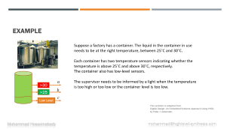


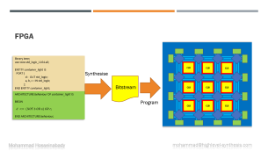
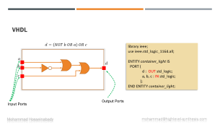
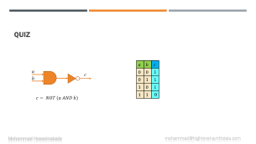
Topics in this Session

Slide 3

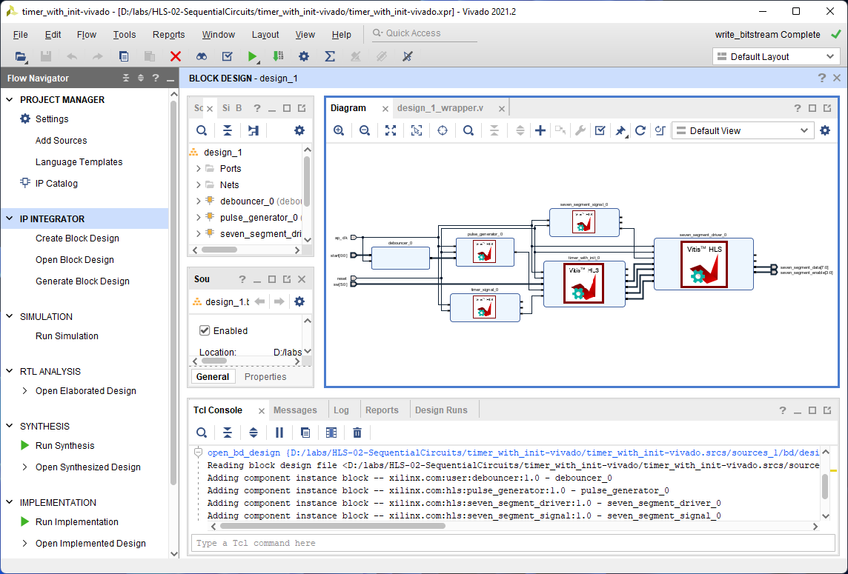

Reference
Software Tool
Digital Design: An Embedded Systems Approach Using VHDL
by Peter J. Ashenden
https://www.xilinx.com/support/download.html

Slide 4
Topics in this Course
Concepts of Digital Systems
Combinational Circuits
Numeric Systems
I/O Interfaces
Memories
Sequential Basics

Slide 5
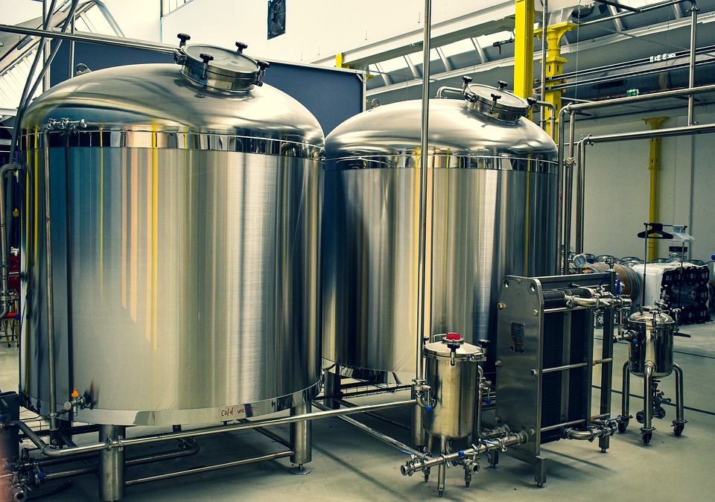
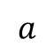
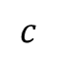
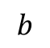
Example
Suppose a factory has a container. The liquid in the container in use needs to be at the right temperature, between 25˚C and 30˚C.
Each container has two temperature sensors indicating whether the temperature is above 25˚C and above 30˚C, respectively.
The container also has low-level sensors.
The supervisor needs to be informed by a light when the temperature is too high or too low or the container level is too low.
$$a$$
>30
$$b$$
>25
$$c$$
Low Level
This problem is adapted from
Digital Design: An Embedded Systems Approach Using VHDL
by Peter J. Ashenden

Slide 6








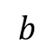
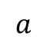




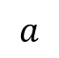
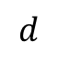




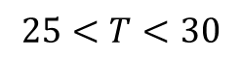






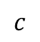






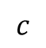
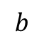





Logic Table
$$a$$
$$a$$
$$b$$
$$c$$
$$d$$
$$25<T<30$$
>30
$$0$$
$$0$$
$$0$$
$$1$$
$$b$$
>25
$$0$$
$$0$$
$$1$$
$$1$$
$$c$$
$$0$$
$$1$$
$$0$$
$$0$$
Low Level
$$0$$
$$1$$
$$1$$
$$1$$
$$1$$
$$0$$
$$0$$
$$1$$
$$a$$
Logic Circuit
$$1$$
$$0$$
$$1$$
$$1$$
$$d$$
$$b$$
$$1$$
$$1$$
$$0$$
$$1$$
$$c$$
$$1$$
$$1$$
$$1$$
1

Slide 7








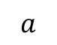
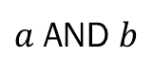


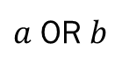
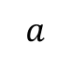





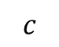




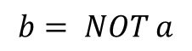



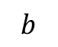
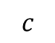







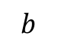
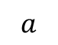
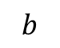







Logic Gates
$$a$$
$$a$$
$$c$$
$$c$$
$$a$$
$$b$$
$$b$$
$$b$$
$a$ OR $b$
$$b= NOT a$$
$a$ AND $b$
$$a$$
$$b$$
$$c$$
$$a$$
$$b$$
$$c$$
$$0$$
$$0$$
$$0$$
$$a$$
$$b$$
$$0$$
$$0$$
$$0$$
$$0$$
$$1$$
$$1$$
$$0$$
$$1$$
$$0$$
$$1$$
$$0$$
$$1$$
$$0$$
$$1$$
$$1$$
$$0$$
$$1$$
$$0$$
$$0$$
$$1$$
$$1$$
$$1$$
$$1$$
$$1$$
$$1$$

Slide 8











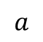







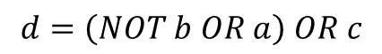
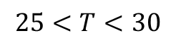







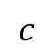






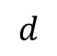
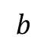
Design
$$a$$
$$b$$
$$c$$
$$d$$
$$0$$
$$0$$
$$0$$
$$1$$
$$0$$
$$0$$
$$1$$
$$1$$
$$25<T<30$$
$$0$$
$$1$$
$$0$$
$$0$$
Logic Circuit
$$0$$
$$1$$
$$1$$
$$1$$
$$a$$
>30
$$1$$
$$0$$
$$0$$
$$1$$
$$b$$
$$d$$
>25
$$1$$
$$0$$
$$1$$
$$1$$
$$c$$
$$1$$
$$1$$
$$0$$
$$1$$
Low Level
$$1$$
$$1$$
$$1$$
1
$$d=\left(NOT b OR a\right) OR c$$

Slide 9


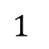
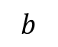
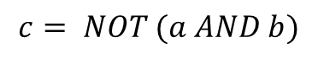


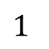
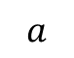







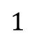
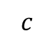


Quiz
$$a$$
$$b$$
$$c$$
$$a$$
$$0$$
$$0$$
$$1$$
$$c$$
$$b$$
$$0$$
$$1$$
$$1$$
$$1$$
$$0$$
$$1$$
$$1$$
$$1$$
$$0$$
$$c= NOT (a AND b)$$

Slide 10


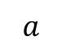
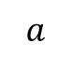

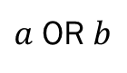


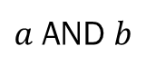
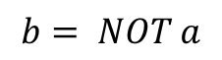


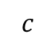
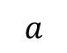


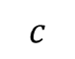


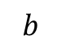










Quiz
$$a$$
$$a$$
$$c$$
$$c$$
$$a$$
$$b$$
$$b$$
$$b$$
$$a$$
$$b$$
$$c$$
$a$ OR $b$
$$b= NOT a$$
$a$ AND $b$
$$0$$
$$0$$
$$1$$
$$0$$
$$1$$
$$0$$
$$1$$
$$0$$
$$0$$
$$a$$
$$1$$
$$1$$
$$0$$
$$c$$
$$b$$
$$c= NOT (a OR b)$$

Slide 11












































Quiz
$$a$$
$$a$$
$$c$$
$$c$$
$$a$$
$$b$$
$$b$$
$$b$$
$a$ OR $b$
$$b= NOT a$$
$a$ AND $b$
$$a$$
$$b$$
$$c$$
$$d$$
$$0$$
$$0$$
$$0$$
$$1$$
$$0$$
$$0$$
$$1$$
$$0$$
$$0$$
$$1$$
$$0$$
$$0$$
$$0$$
$$1$$
$$1$$
$$0$$
$$a$$
$$b$$
$$d$$
$$1$$
$$0$$
$$0$$
$$1$$
$$1$$
$$0$$
$$1$$
$$0$$
$$1$$
$$1$$
$$0$$
$$1$$
$$c$$
$$1$$
$$1$$
$$1$$
$$0$$

Slide 12





VHDL
$$d=\left(NOT b OR a\right) OR c$$
library ieee;
use ieee.std_logic_1164.all;
ENTITY container_light IS
PORT (
d : OUT std_logic;
a, b, c : IN std_logic;
);
END ENTITY container_light;
Logic Circuit
$$a$$
$$d$$
$$b$$
$$c$$
Output Ports
Input Ports

Slide 13






VHDL
library ieee;
use ieee.std_logic_1164.all;
ENTITY container_light IS
PORT (
d : OUT std_logic;
a, b, c : IN std_logic;
);
END ENTITY container_light;
Logic Circuit
$$a$$
$$d$$
$$b$$
$$c$$
ARCHITECTURE behaviour OF container_light IS
BEGIN
$d <= (NOT b OR a) OR c;$
END ARCHITECTURE behaviour;
$$d=\left(NOT b OR a\right) OR c$$

Slide 14





Quiz
library ieee;
use ieee.std_logic_1164.all;
ENTITY container_light IS
PORT (
d : OUT std_logic;
a, b, c : IN std_logic;
);
END ENTITY container_light;
$$a$$
$$b$$
$$d$$
ARCHITECTURE behaviour OF container_light IS
BEGIN
$d <= \left(NOT b OR a\right)AND(NOT c);$
END ARCHITECTURE behaviour;
$$c$$

Slide 15


FPGA
library ieee;
use ieee.std_logic_1164.all;
ENTITY container_light IS
PORT (
d : OUT std_logic;
a, b, c : IN std_logic;
);
END ENTITY container_light;
Synthesise
Bitstream
ARCHITECTURE behaviour OF container_light IS
BEGIN
$d <= (NOT b OR a) OR c;$
END ARCHITECTURE behaviour;
Program

Slide 16





FPGA Basys3
FPGA
Logic Circuit
$$a$$
$$d$$
$$b$$
$$c$$
16 LEDs
16 Slide Switches

Slide 17




FPGA Basys3
BASYS3 BOARD
FPGA
Design in VHDL
Logic Circuit
$$a$$
$$b$$
$$d$$
$$c$$
Constraint Files

Slide 18


Slide 19
Quiz
library ieee;
use ieee.std_logic_1164.all;
ENTITY container_light IS
PORT (
d : OUT std_logic;
a, b, c : IN std_logic;
);
END ENTITY container_light;
$$a$$
$$b$$
$$d$$
ARCHITECTURE behaviour OF container_light IS
BEGIN
$d <= \left(NOT b OR a\right)AND(NOT c);$
END ARCHITECTURE behaviour;
$$c$$

Slide 20

Questions

